Slide 1

INTRODUCTION TO POWER QUERY FOR EXCEL

Slide 2

George Mount
Data Analyst & Educator at Stringfest Analytics
George works as an independent analyst and data analytics educator with the goal to help clients manage their data so they think more creatively. He serves as a technical expert and lead curriculum developer for Thinkful’s data analytics program and is the instructor of the DataCamp course “Survey and Measure Development in R.”
George blogs about data, innovation, and career development at georgejmount.com. He holds a master’s degree in information systems with a certificate of achievement in quantitative methods from Case Western Reserve University

Slide 3

OBJECTIVES FOR TODAY
Load data from Excel workbooks and csv files into Power Query
Perform common data wrangling and cleaning tasks
Combine data from multiple sources
Excel Statistics for Business Analytics

Slide 4
FOLLOWING ALONG
Each section is a sub-folder in the repo
Demos = follow along with me
Drills = try it yourself
Refresh your memory with the demo notes
Excel Statistics for Business Analytics
Notes:
This is an Excel class, so we won’t be looking at PowerPoint the whole time – to follow along, you will see that all assets are divided by section.
Some of our Excel time will be Demos – for this I will be walking through some procedure in Excel.
If you need any datasets they will be included in each sub-folder.
Then there may be a Drill where you will work on it for yourself during some specified period of time.
I have provided written notes/instructions about the Demos which you can refer to while working on the Drills.

Slide 5
1. POWER QUERY AS EXCEL’S ETL TOOL

Slide 6

What the @%&! is ETL?
“A properly designed ETL system extracts data from the source systems, enforces data quality and consistency standards, conforms data so that separate sources can be used together, and finally delivers data in a presentation-ready format so that application developers can build applications and end users can make decisions.”
-- (where else but) Wikipedia

Slide 7








1. EXTRACT
2. TRANSFORM
3. LOAD
Notes:
https://unsplash.com/photos/QUHlPs4y8PQ
https://pixabay.com/photos/tee-tea-bags-teas-drink-herbal-tea-1252397/
https://pixabay.com/photos/construction-worker-welding-welder-1717893/
https://pixabay.com/photos/gift-box-gifts-packaging-box-2458012/

Slide 8

Power Query & Excel Myth-busting
https://giphy.com/gifs/mythbusters-gif-qVuWpc7MxvGz6

Slide 9

1. “EXCEL IS NOT REPRODUCIBLE”
Notes:
https://pixabay.com/photos/laboratory-analysis-chemistry-2815641/

Slide 10

2. “EXCEL ONLY DOES STRUCTURED DATA”
Notes:
https://pixabay.com/illustrations/grid-isolation-table-lamp-beetle-2088884/

Slide 11
Access
.txt and .csv files
SQL Server & other relational databases
XML, HTML & Web data
SharePoint
Hadoop
oData
Combinations of the above…

Slide 12

3. “EXCEL CAN’T HANDLE LARGE DATASETS”
Notes:
https://pixabay.com/photos/amphibian-turtle-animal-armor-blur-1850190/

Slide 13
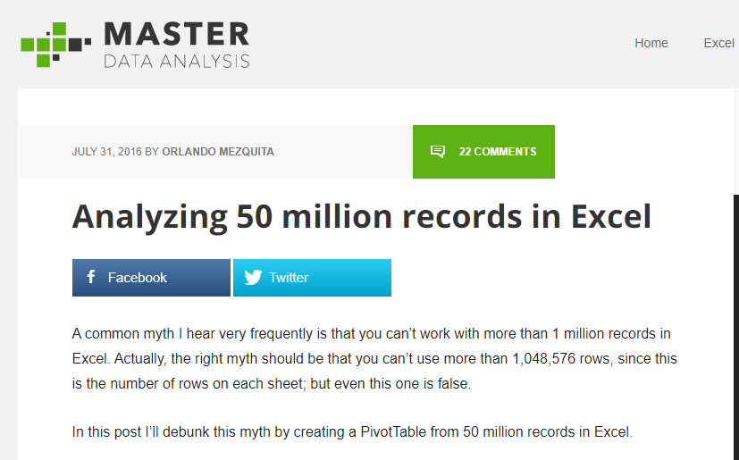
https://www.masterdataanalysis.com/ms-excel/analyzing-50-million-records-excel/

Slide 14
What did we do before Power Query?
File: wholesale-customers.xlsx
How would you make this data “PivotTable-ready?”

Slide 15
QUESTIONS?
Notes:
Any questions on descriptive statistics?

Slide 16
2. WHAT MAKES DATA TIDY?

Slide 17
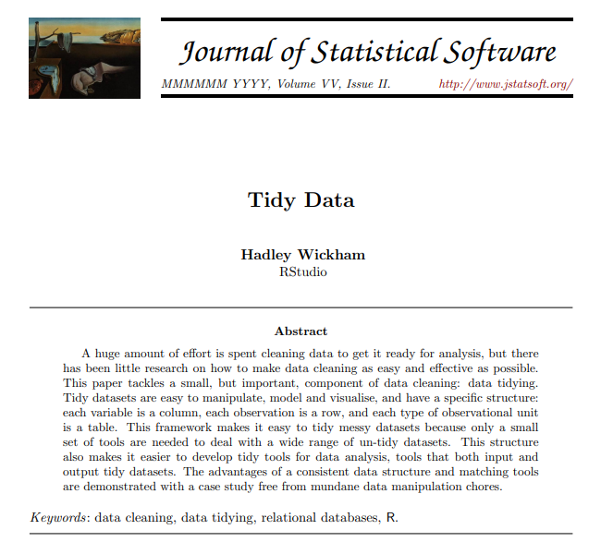
TIDY’S ORIGINS
http://vita.had.co.nz/papers/tidy-data.pdf
Notes:
I have included a copy of this paper in the repo, you can also download it at the link.

Slide 18
OBSERVATIONS AND VARIABLES
Observation: The unit that was measured
Variable: What was measured
Notes:
Any questions on descriptive statistics?

Slide 19
DRILL
Which attributes are observations, and which are variables?
Attribute | Observation or variable?
Store #
Month
Sales
Notes:
Any questions on descriptive statistics?

Slide 20
DRILL
Which attributes are observations, and which are variables?
Attribute | Observation or variable?
Store # | Observation
Month | Observation
Sales | Variable
Notes:
Any questions on descriptive statistics?

Slide 21
WHAT MAKES DATA TIDY?
Notes:
Any questions on descriptive statistics?

Slide 22

Notes:
It’s not even like a box of chocolates, because we KNOW we are going to get something dirty & unfit for consumption.

Slide 23
DRILL
How would we tidy this dataset?
Notes:
Any questions on descriptive statistics?

Slide 24
SOLUTION
How would we tidy this dataset?
Notes:
Any questions on descriptive statistics?

Slide 25
DRILL
How would we tidy this dataset?
Notes:
Any questions on descriptive statistics?

Slide 26
SOLUTION
How would we tidy this dataset?
Notes:
Any questions on descriptive statistics?

Slide 27
QUESTIONS?
Notes:
Any questions on descriptive statistics?

Slide 28
3. FIRST STEPS IN POWER QUERY

Slide 29
DEMO
File: star.xlsx
Load into Power Query
Explore via Data Preview
Notes:
Any questions on descriptive statistics?

Slide 30
DRILL
File: computers.xlsx
Load into Power Query
Explore via Data Preview
Notes:
Any questions on descriptive statistics?

Slide 31
QUESTIONS?
Notes:
Any questions on descriptive statistics?

Slide 32
4. TRANSFORMING ROWS IN POWER QUERY

Slide 33
DEMO
File: office-rsvps.xlsx
Notes:
Any questions on descriptive statistics?

Slide 34
DEMO
File: regional-sales.xlsx
Notes:
Any questions on descriptive statistics?

Slide 35
DRILL
File: state-populations.xlsx
Name the query State populations.
Remove the United States row from the data.
Fill down blanks on the Region and Division columns
Sort by Population from high to low
Load results into a PivotTable
Notes:
Any questions on descriptive statistics?

Slide 36
DRILL
File: orders.xlsx
Convert the Date column to a month data type.
Convert the Account column to proper case.
Split the Opportunity column into three columns:
Vendor
Status
Order Type
Notes:
Any questions on descriptive statistics?

Slide 37
QUESTIONS?
Notes:
Any questions on descriptive statistics?

Slide 38
5. TRANSFORMING COLUMNS IN POWER QUERY, PART I

Slide 39
DEMO
File: dvdrentals.xlsx
Notes:
Any questions on descriptive statistics?

Slide 40
DRILL
File: orders.xlsx
Convert the Date column to a month data type.
Convert the Account column to proper case.
Split the Opportunity column into three columns:
Vendor
Status
Order Type
Notes:
Any questions on descriptive statistics?

Slide 41
QUESTIONS?
Notes:
Any questions on descriptive statistics?

Slide 42
6. TRANSFORMING COLUMNS IN POWER QUERY, PART II

Slide 43
6A. Transforming Columns

Slide 44
DEMO
File: population-densities.xlsx
Notes:
Any questions on descriptive statistics?

Slide 45
DRILL
File: wholesale-customers.xlsx
Tidy this data!
Create a field calculating 10% of the sales called Tax
Notes:
Any questions on descriptive statistics?

Slide 46
6B. Appending Tables

Slide 47
DEMO
Files: oscars_yes.csv, oscars_no.csv
Notes:
Any questions on descriptive statistics?

Slide 48
DRILL
File: hof_inducted.xlsx, hof_not_inducted.xlsx
Append these tables
Notes:
Any questions on descriptive statistics?

Slide 49
QUESTIONS?
Notes:
Any questions on descriptive statistics?

Slide 50
QUESTIONS?
I have one:
Who are these people?
Notes:
Any questions on descriptive statistics?

Slide 51
6. VLOOKUP(), MEET JOIN

Slide 52
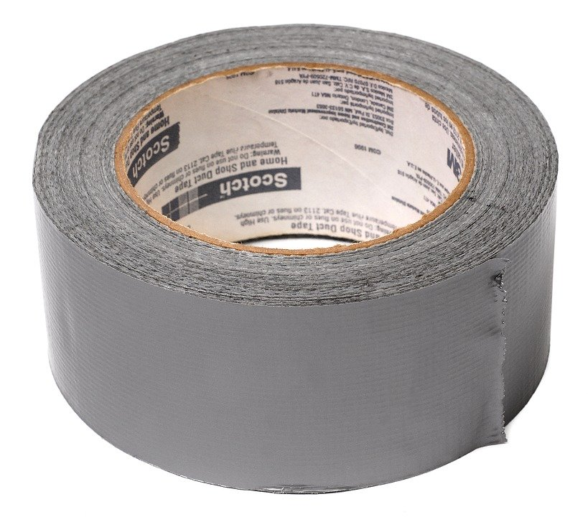

DUCT TAPE, MEET WELDER
VLOOKUP()
JOIN

Slide 53

INNER JOIN:
Returns records that have matching values in Tables A and B
https://github.com/gadenbuie/tidyexplain#mutating-joins
Notes:
These are R functions but the idea is the same.

Slide 54
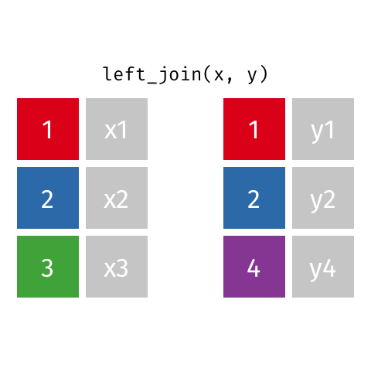
LEFT OUTER JOIN:
Returns ALL records from Table A and matching records from Table B. Results with no match are null.
https://github.com/gadenbuie/tidyexplain#mutating-joins

Slide 55
DEMO
File: flights-and-planes.xlsx
Notes:
Any questions on descriptive statistics?

Slide 56
DRILL
Files: hof.csv, people-a-thru-m.csv
What is the result of a left outer join of hof on people-a-thru-m?
What about an inner join?
Notes:
Any questions on descriptive statistics?

Slide 57
7. CONCLUSION

Slide 58
What to learn next?
M language
PowerPivot
Power BI
Notes:
Manipulating the M language: This will let you write things like custom functions
Power Pivot: This is the data modeling language.
Power BI: This is the dashboarding/reporting/visualization part of the Microsoft BI stack.

Slide 59

Collect, Combine, and Transform Data Using Power Query in Excel and Power BI, 1st Edition
by Gil Raviv
On O’Reilly Learning at https://learning.oreilly.com/library/view/collect-combine-and/9781509307982/
Human Centered Design • MDLS 2020
Notes:
This one is a real tour de force in pushing your Power Query capabilities, it will also show you Power BI stuff if you are interested in that.

Slide 60

Excel Power Pivot and Power Query For Dummies,
by Mike Alexander
On O’Reilly Learning at https://learning.oreilly.com/library/view/excel-power-pivot/9781119210641/
Human Centered Design • MDLS 2020
Notes:
This one is a little more user friendly, it focuses on Excel and you will also learn about Power Pivot as well.

Slide 61
LET'S TALK
LINKEDIN
linkedin.com/in/gjmount
EMAIL ADDRESS
george@stringfestanalytics.com
WEBSITE
stringfestanalytics.com
GITHUB
github.com/summerofgeorge
Notes:
Thanks for coming! Feel free to contact me anytime, find me on LinkedIn, I also write frequently on this stuff so check out my website too.

